Slide 1


(Jain Deemed-To-Be-University)
Presentation on
AI-Based Onilne Quiz Management System
By:Aditi Kumari Dubey
Boggavarapu Suriya
Charan Chakravarthi
Dikshita Dutta

Slide 2

Contents
Introduction
Scope
Objective
System Design
Implementation and Analyisis
Software
Sample Output
Conclusion

Slide 3

INTRODUCTION
The AI-based Online Quiz Management System is a web-based application designed to facilitate quiz creation, management, and participation. It integrates artificial intelligence to enhance user experience by recommending quizzes based on past performance and interests. The system is built using Python and Flask, utilizing a relational database for user authentication, quiz storage, and result tracking.

Slide 4
SCOPE
The AI-based Online Quiz Management System is designed to provide a robust and scalable solution for online assessments. The key areas of scope include:
Quiz Management: Enables users to create, edit, and delete quizzes with multiple question types, including multiple-choice, true/false, and descriptive questions.
Database Management: Uses SQLAlchemy with SQLite or PostgreSQL for efficient storage and retrieval of quiz-related data.
Performance Analytics: Tracks user performance and provides insights through visual reports and progress monitoring.
Scalability and Accessibility: Designed to be scalable for large numbers of users and accessible from different devices through a responsive web interface.

Slide 5
OBJECTIVE
The objective of this project is to provide an interactive and intelligent quiz platform that enables students, teachers, and professionals to create and take quizzes efficiently.
The AI-driven recommendation system personalizes the quiz experience by suggesting relevant quizzes. The platform aims to enhance learning through adaptive question selection, performance tracking, and an intuitive user interface.

Slide 6
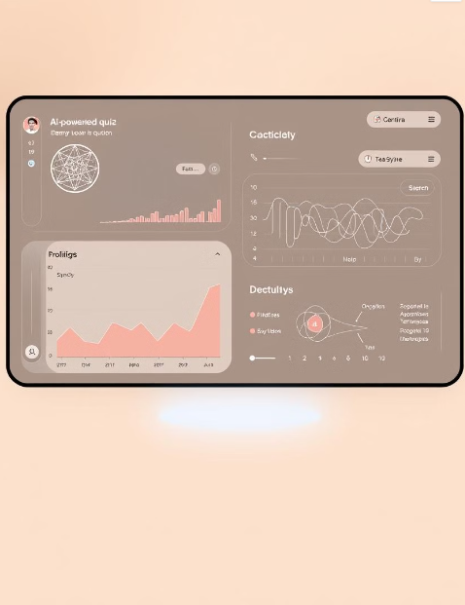
System Design
Hardware Requirements
Minimum 4GB RAM
Intel i3 or higher processor
10GB free storage
Software Requirements
Python 3.8+
Flask Framework
SQLite Database
scikit-learn, NLTK libraries
Bootstrap for UI design

Slide 7
Implementation and Analysis
Python Librararies
Flask
Flask is a lightweight and flexible web framework for Python. It follows the WSGI standard and provides tools, libraries, and mechanisms to build web applications.
Flask-SQLAlchemy
Flask-SQLAlchemy integrates SQLAlchemy, a powerful ORM, with Flask, allowing developers to interact with databases using Python objects instead of raw SQL queries.
Flask-WTF
Flask-WTF is a Flask extension that simplifies working with forms using WTForms. It provides form validation, CSRF protection, and easier integration of HTML forms with Flask applications.

Slide 8
Cont..
NLTK (Natural Language Toolkit)
NLTK is a comprehensive library for working with human language data (text processing and analysis). It provides tools for tokenization, stemming, lemmatization, parsing, and more.
Scikit-learn
Scikit-learn is a powerful machine learning library built on NumPy, SciPy, and Matplotlib. It provides tools for classification, regression, clustering, dimensionality reduction, and model evaluation.
NumPy
NumPy (Numerical Python) is the core library for numerical computations in Python. It provides support for large multidimensional arrays, matrices, and mathematical functions

Slide 9
Software
Python
Python is an interpreted, object-oriented, high-level programming language with dynamic semantics
Its high-level built in data structures, combined with dynamic typing and dynamic binding, make it very attractive for Rapid Application Development
Python's simple, easy to learn syntax emphasizes readability and therefore reduces the cost of program maintenance
Visual Studio Code (VS Code)
Visual Studio Code (VS Code) is a free, lightweight, and powerful source code editor developed by Microsoft.
It supports multiple programming languages, including Python, JavaScript, C++, and Java, making it a versatile choice for developers.
VS Code comes with built-in Git support, debugging tools, and an integrated terminal, allowing seamless workflow management

Slide 10

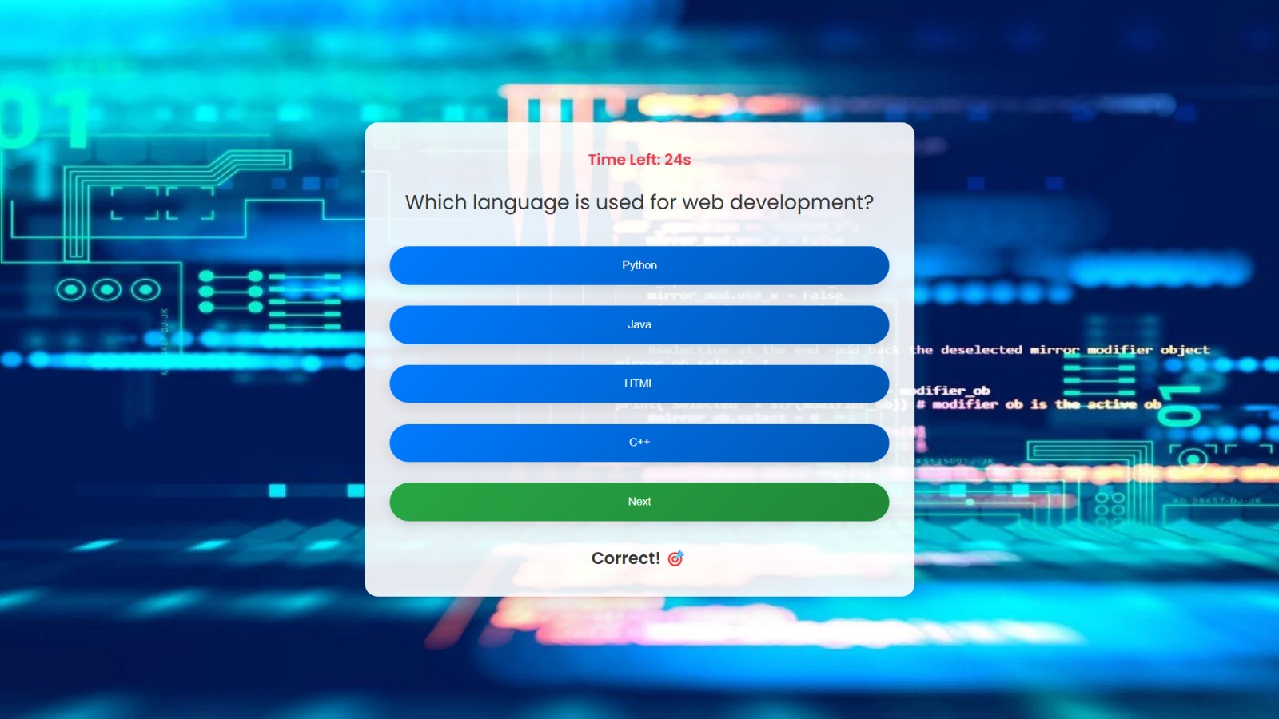
Sample Output
USERNAME
USER RESPONSE 1

Slide 11
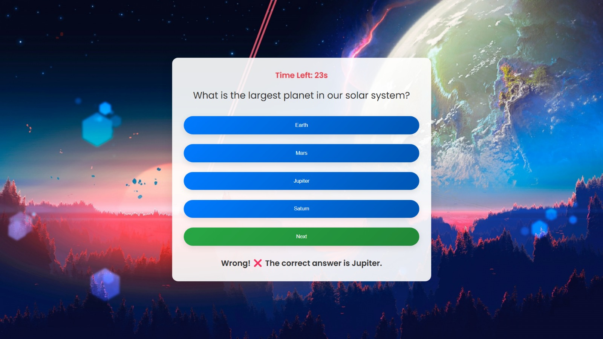

Cont..
USER RESPONSE 2
LEADERBOARD

Slide 12

Conclusion
The Online Quiz Management System is an AI-powered platform designed to enhance the learning experience through interactive and personalized quizzes. The system incorporates user authentication, quiz creation, intelligent recommendations, and performance tracking, making it an effective tool for students, educators, and organizations.

